Slide 1
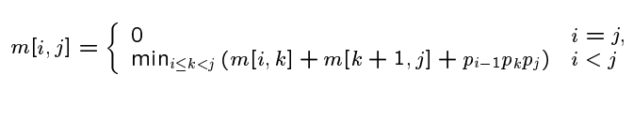
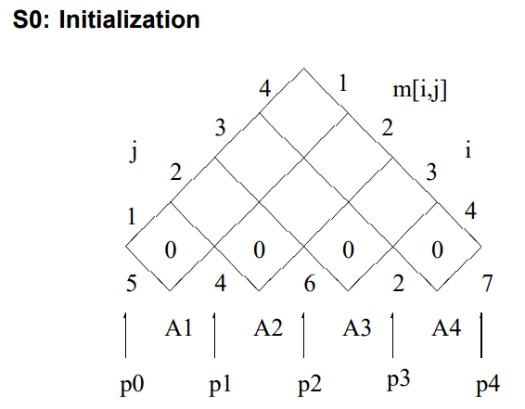
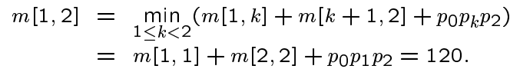
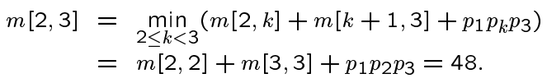
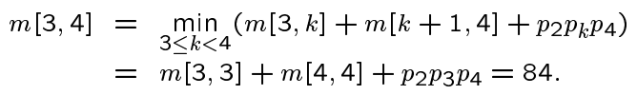
A1 × A2 × A3 × A4
5 × 4 4 × 6 6 × 2 2 × 7
p0 p1 p1 p2 p2 p3 p3 p4

Slide 2
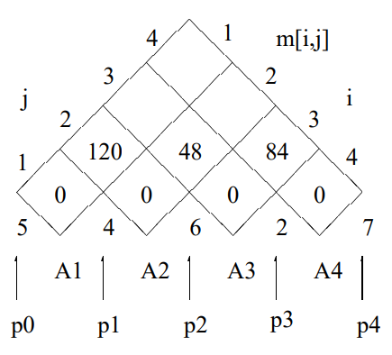
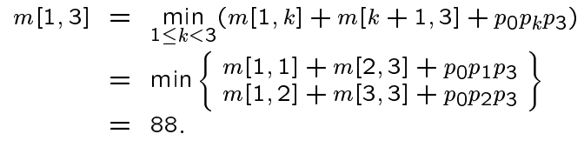
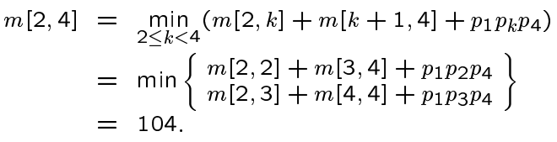




A1 × A2 × A3 × A4
5 × 4 4 × 6 6 × 2 2 × 7
p0 p1 p1 p2 p2 p3 p3 p4

Slide 3
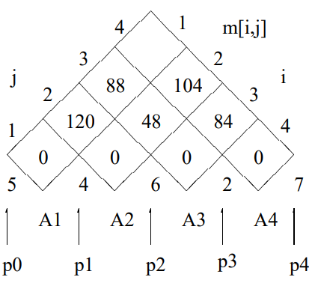
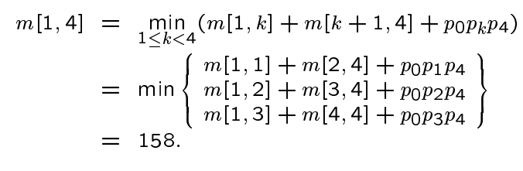


A1 × A2 × A3 × A4
5 × 4 4 × 6 6 × 2 2 × 7
p0 p1 p1 p2 p2 p3 p3 p4

Slide 4
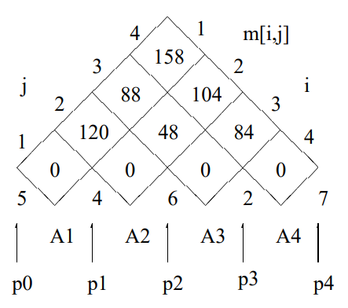
A1 × A2 × A3 × A4
5 × 4 4 × 6 6 × 2 2 × 7
p0 p1 p1 p2 p2 p3 p3 p4
Where Do We Put Our Brackets ?
We must focus on selected k values.

Slide 5
A1 × A2 × A3 × A4
We must focus on
selected k values.
5 × 4 4 × 6 6 × 2 2 × 7
p0 p1 p1 p2 p2 p3 p3 p4
K=3
(A1 × A2 × A3) × A4

Slide 6
A1 × A2 × A3 × A4
We must focus on
selected k values.
5 × 4 4 × 6 6 × 2 2 × 7
p0 p1 p1 p2 p2 p3 p3 p4
K=1
((A1) × (A2 × A3)) × A4

Slide 7
(A1 × (A2 × A3)) × A4
5 × 4 4 × 6 6 × 2 2 × 7
4*6*2 = 48
4 × 2
5*4*2 = 40
5 × 2
5*2*7 = 70
5 × 7
48 + 40 + 70 = 158

